Slide 1
Assemblies & Reflection

Slide 2
Objectives
Introducing assemblies
Assembly metadata & demo on ILDASM tool
Shared V/s private assemblies
What is strong name
Installing assembly in GAC, versioning and updating configuration file
Understanding reflection
Reflection classes
Usage of reflection

Slide 3
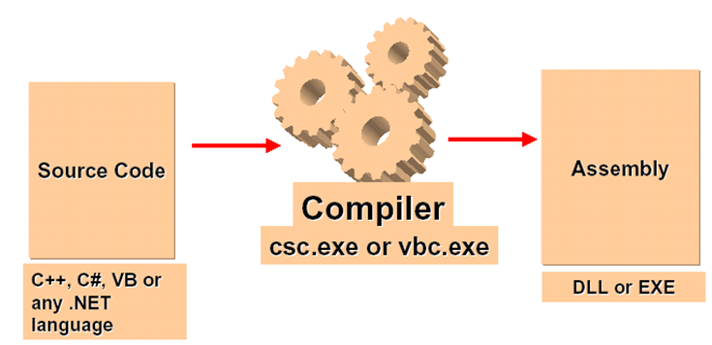
Assembly
An assembly is a logical and functional unit of deployment , version control, reuse, activation scoping, and security permissions.
An assembly is simply a Portable Executable (PE) file, with either .exe or .dll extension, generated as a result of compilation of any .NET application.
Depending on O/S either it is PE32 or PE64 file.
Notes:
PE32 file: Portable-Executable file for 32-bit operating system.
PE64 file: Portable-Executable file for 64-bit operating system.
Any assembly is a standard PE32 or PE64 file.

Slide 4
Contents of an Assembly
In general, an assembly can consist of four elements
The Assembly Manifest
Type Metadata
Microsoft Intermediate Language (MSIL) code
A set of resources.
Additionally every assembly contain two header values
Win32 Header
CLR Header
All the contents are stored in a PE file (.exe or .dll)
Assembly Manifest
Type Metadata
Resource Files
IL Code
Win32 Header
CLR Header
Notes:
The Assembly Manifest: It contains assembly metadata.
Type Metadata, which is nothing but detailed information about all the data types that you have used directly and indirectly in your application code.
Microsoft Intermediate Language (MSIL) code that implements the types.
Additionally every assembly contain two header values
Win32 Header
CLR Header

Slide 5
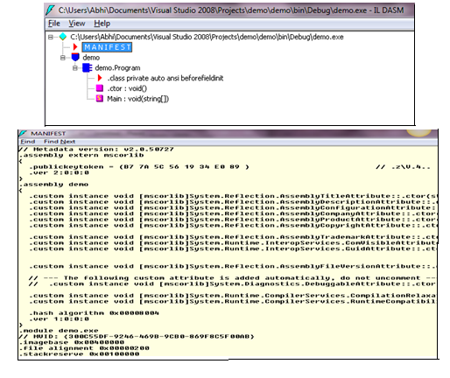
Assembly Manifest/Metadata
It is one part of assembly, which is present in the PE File.
It contains general information about an assembly, which includes
Version no of assembly
Extension of assembly (.dll or .exe)
References to other assemblies
Public key etc.
Notes:
Public key: it is a cryptographic key used for Hashing technique (one of the security feature to secure any data). It is 64/128b bit alphanumeric key. It can be generated by SN.EXE tool in .NET. It is used in .NET framework to secure an assembly as well as to convert a private assembly into a shared assembly (will be discussed in next few slides).
Version No: Such as, 1.0.0.0 (Major-1, Minor-0, Build-0 and Revision-0 no)

Slide 6
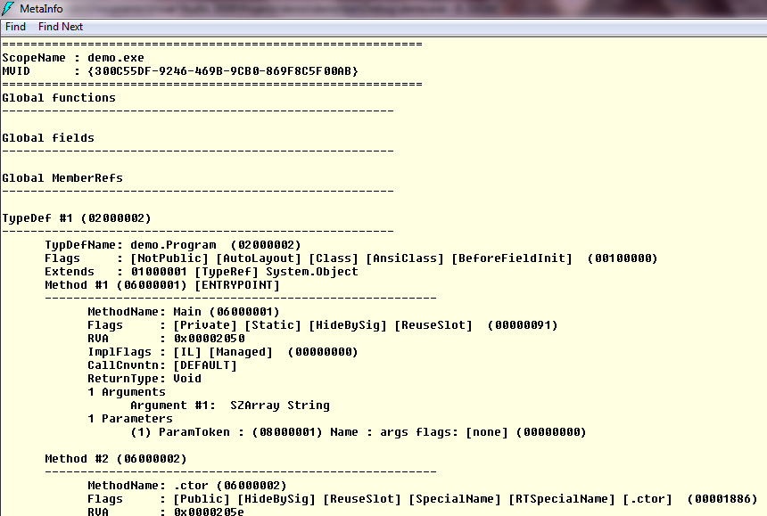
Type Metadata
It is one part of that PE file.
It includes detailed information of
All data types declared in the code
Members of those data types even
User strings
Also, small detail of assembly
Notes:
Type Metadata includes….
All data types that you have used directly or indirectly (such as, you have inherited a class from another class which is not part of that application code, but part of some other assembly)
All members of every data types, such as methods, properties etc.
User strings (such as, you have used WriteLine method of Console class to print some string)
Also. small amount of information about the assembly ,too.

Slide 7
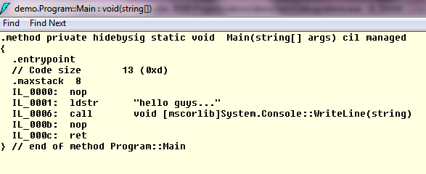
Microsoft Intermediate Language (MSIL) Code
IL (Intermediate Language) is assembly-level language.
Also, known as MSIL (Microsoft Intermediate Language) or CIL (Common Intermediate Language)
The application source code is compiled into IL code when the source code is compiled by corresponding language compiler and placed in one part of the PE file (the output file).

Slide 8
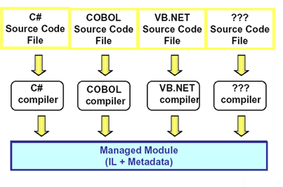
Microsoft Intermediate Language (MSIL) Code
Stack based, CPU independent set of instructions that can be efficiently converted to a native code.
All the codes are first converted into MSIL code
Designed to generate to produce optimized native code at reasonable speed and efficiency
Designed to generate type-safe code, but also allows the codes that are not type-safe
Also called managed code, because CLR manages everything starting from cross-language integration, cross-language exception handling, enhanced security, versioning and deployment support etc.

Slide 9
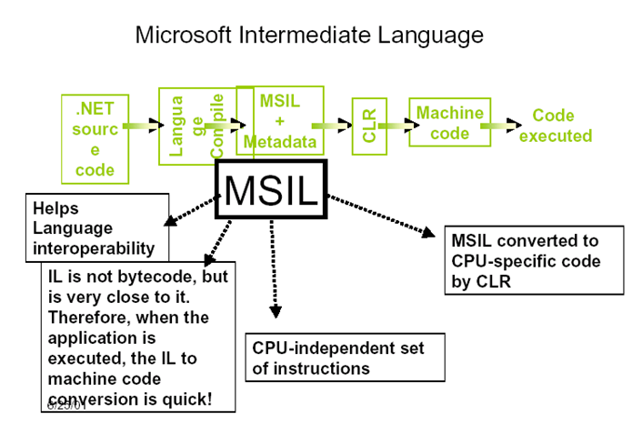
Main Advantages of IL Code
It helps in interoperability
It provides platform independency/neutrality
It uses CTS data types. That means different data types of different languages will be converted into same data type. As for example, ‘int’ data type of C# and ‘Integer’ data type of VB.NET, both of them will be converted into CTS data type ‘Int32. This conversion helps to avoid memory allocation problem for CLR.
Notes:
This code is machine-independent set of instructions. That is why this code platform neutral.
2. You can deploy the assembly (PE file) in any machine and then using CLR, the IL code will be converted into Native or machine level code, and then will be executed.
3. Every source code written into different .NET compatible language is converted into IL code first. That is why you can integrate module written in different languages so easily because all the source codes have been converted into IL code and actually the integration is taking place between IL codes. It provides respite to the problem of interoperability.

Slide 10
Resources
It stores information about any image file, icon, audio file, video file, which are used by the assembly (application)
This is optional part of the assembly, i.e., if the application does not use those files, there will be no Resource segment in the assembly

Slide 11
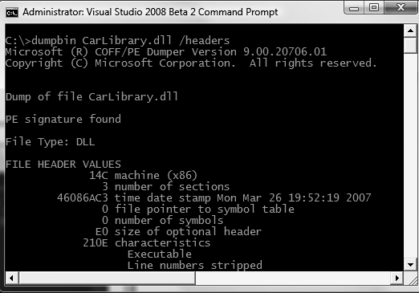
Win32 Header
The Win32 file header establishes the fact that the assembly can be loaded and manipulated by the
Windows family of operating systems. This header data also identifies the kind of application (console-
based, GUI-based, or *.dll code library) to be hosted by the Windows operating system.
Notes:
1. If you open a .NET assembly using the dumpbin.exe utility (via a Visual Studio 2008 command prompt) and specify the /headers flag, you can view an assembly’s Win32 header information.

Slide 12
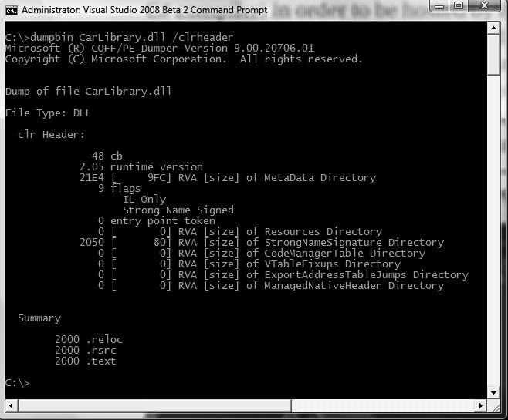
CLR Header
The CLR header is a block of data that all .NET files must support (and do support, courtesy of the C# compiler) in order to be hosted by the CLR.
Notes:
This header defines numerous flags that enable the runtime to understand the layout of the managed file.
For example, flags exist that identify the location of the metadata and resources within the file, the version of the runtime the
assembly was built against, the value of the (optional) public key, and so forth.
3. If you supply the /clrheader flag to dumpbin.exe, you are presented with the internal CLR header information for a given .NET assembly.

Slide 13
Advantages of Assembly
It contains code (IL Code) that the common language runtime executes.
It forms a security boundary.
It forms a type boundary.
It forms a reference scope boundary.
It forms a version boundary.
It forms a deployment unit.
It is the unit at which side-by-side execution is supported.
Notes:
Advantages of an Assembly:
1. Assembly contains Microsoft intermediate language (MSIL) code in a portable executable (PE) file (i.e., .exe/.dll file) common language runtime executes.
2. Assembly forms a security boundary since it is the unit at which permissions are requested and granted.
3. Every data type's identity includes the name of the assembly in which it resides. A data type (say, a class) called MyClass that is part of one assembly is not the same as a data type called MyClass that is part of another assembly.
4. The assembly's manifest contains assembly metadata that is used for resolving types and satisfying resource requests. It specifies the types and resources that are exposed outside the assembly. The manifest also includes information about other assemblies on which it depends.
5. The assembly is the smallest versionable unit in the common language runtime; all types and resources in the same assembly are versioned as a unit. The assembly's manifest describes the version dependencies you specify for any dependent assemblies.
6. When an application starts, only the assemblies that the application initially calls must be present. Other assemblies, such as localization resources or assemblies containing utility classes, can be retrieved on demand. This allows applications to be kept simple and thin when first downloaded.
7. Side-by-side execution is the ability to store and execute multiple versions of an application or component on the same computer. This means that you can have multiple versions of the runtime, and multiple versions of applications and components that use a version of the runtime, on the same computer at the same time. Side-by-side execution gives you more control over what versions of a component an application binds to, and more control over what version of the runtime an application uses.

Slide 14
How to view contents of an Assembly
There are two techniques to view the contents of an assembly
To view an assembly’s contents you can use ILDASM tool
Also, you can use Reflection technique to programmatically extract or view all contents of an assembly.

Slide 15
ILDASM tool
Contents of an assembly can be viewed using a tool, named ILDASM.EXE
ILDASM stands for Intermediate Language Dis-Assembler
You can use this tool in two ways
Use the tool from Visual Studio 2008 Command Prompt by typing proper command or by adding the tool first in Visual Studio Tools Menu and then use it.
You can add this tool in Tools Menu in the Visual Studio.
Location of the tool
C:\Program Files\Microsoft SDKs\Windows\v6.0A\Bin
You can open any PE (Portable Executable) file (with .exe/.dll extension) created using .NET Framework.
Notes:
Open Visual Studio 2008 Command Prompt and then type ildasm in the console to run the tool.
Then from File menu, select Open submenu and select the file (.exe or .dll) that you want to open.

Slide 16
Reflection
Reflection is technique, using which we can discover the assembly contents (manifest data, type metadata etc.) during run-time.
Since, this technique is used to discover data types used in an assembly during runtime, that is why reflection is also known as Run-time Type Discovery.
Using Reflection technique, by using metadata of any data type from other assembly an object of that type can be created during time. This technique is known Dynamic Object Creation.
Using metadata of members of any data type we can invoke any method also. This technique is known as Dynamic Method Invocation.

Slide 17
Namespace and Types for Reflection
The necessary classes and other data types that are required to use Reflection technique are present in System.Reflection namespace.
Classes like Assembly, MemberInfo, FieldInfo,PropertyInfo, MethodInfo etc. are present in that namespace.
Type Class: This class is used to refer to metadata of any data type. This class is present in System namespace.
Notes:
Type Use
------------------------------------------------------------------------------------------------------------------------------------------------------
Assembly This class contains a number of methods that allow you to load, investigate,and manipulate an assembly.
AssemblyName This class allows you to discover numerous details behind an assembly’s identity (version information, culture
information, and so forth).
EventInfo This class holds information for a given event.
FieldInfo This class holds information for a given field.
MemberInfo This is the abstract base class that defines common behaviors for the EventInfo, FieldInfo, MethodInfo, and PropertyInfo
types.
MethodInfo This class contains information for a given method.
Module This class allows you to access a given module within a multifile assembly.
ParameterInfo This class holds information for a given parameter.
PropertyInfo This class holds information for a given property.

Slide 18
How to use Reflection to view assembly contents
1. Load a private or shared assembly during runtime using Assembly Class’s LoadFrom or Load method, respectively.
2. Extract metadata of all types using Assembly class’s GetTypes method or single data type using GetType method.
3. Using Type class’s methods to extract metadata of each and every member of single or every data type.
Notes:
Sample code:
class Program
{
static void Main(string[] args)
{
//Loading private assembly
Assembly testasm = Assembly.LoadFrom(@"D:\Dotnet\TestLib\TestLib\bin\Debug\TestLib.dll");
//Displaying Fully qualified name of the assembly, version,culture etc.
Console.WriteLine("Assembly manifest Info:" + testasm.FullName);
//Extracting Information about data types
Type[] typearr = testasm.GetTypes();
//Display Information aboutall data types
foreach (Type single in typearr)
{
Console.WriteLine("Name: "+single.Name);
Console.WriteLine("IsClass: " + single.IsClass);
}
//Extracting Information about a particular data type
Type atype = testasm.GetType("TestLib.A");
//Extracting method information from A class
MethodInfo[] allmethodsofa = atype.GetMethods();
//Displaying Information of all methods
foreach (MethodInfo singlemethodinfo in allmethodsofa)
{
Console.WriteLine("Method Name: " + singlemethodinfo.Name);
}
}
}

Slide 19
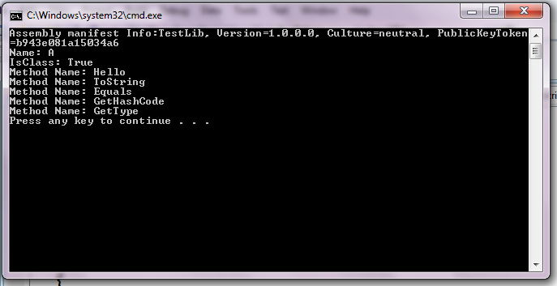
Runtime Type Discovery using Reflection

Slide 20
Strong Name and Strong Named Assembly
A strong name consists of the assembly's identity
Following four values/attributes of an assembly actually reflects the identity
Assembly Title (The simple text name of the assembly)
Assembly Culture
Assembly Version Number
Digital signature, generated with the help of Public/Private key pair.
A Strong Named assembly is the one whose identity consists of all these above mentioned attributes.
An assembly with Strong Name is eligible to be registered with the GAC (Global Assembly Cache- a machine wide cache for assemblies).
Notes:
Formally, a strong name is composed of a set of related data, much of which is specified using assembly-level attributes in AssemblyInfo.cs file:
• The friendly name of the assembly (which you recall is the name of the assembly minus the file extension, assigned using the [AssemblyTitle] attribute)
• The version number of the assembly (assigned using the [AssemblyVersion] attribute)
• The public key value (assigned using the [AssemblyKeyFile] attribute)
• An optional culture identity value for localization purposes (assigned using the [AssemblyCulture] attribute)
• An embedded digital signature created using a hash of the assembly’s contents and the private key value
Public/private key pair: Both of them are alphanumeric numbers (series of characters and digits), which can be generated using a tool, known as SN.EXE, supplied by .NET Framework. They are stored in a file with extension .snk (Strong Name Key).
Digital Signature: it is also a alphanumeric number.

Slide 21
Advantages of Strong-Name
Strong names guarantee name uniqueness by relying on unique key pairs.
Strong names provide a strong integrity check.
A strong name can ensure that no one can produce a subsequent version of your assembly.
Notes:
Strong names guarantee name uniqueness by relying on unique key pairs. No one can generate the same assembly name that you can, because an assembly generated with one private key has a different name than an assembly generated with another private key.
Strong names protect the version lineage of an assembly. A strong name can ensure that no one can produce a subsequent version of your assembly. Users can be sure that a version of the assembly they are loading comes from the same publisher that created the version the application was built with.
A strong name can ensure that no one can produce a subsequent version of your assembly. Users can be sure that a version of the assembly they are loading comes from the same publisher that created the version the application was built with.

Slide 22
How to create a Strong Name for an Assembly?
Create public/private key pair, known as Strong name Key, using SN.EXE tool and put the key pair in a file with .snk extension.
Sign the private assembly with that file containing strong name key.
SN tool can be used for some other purposes also, such as viewing public key from assembly. Use the following command to do that
Sn –Tp <assemblyfile>
Notes:
Create Strong name Key:
To provide a strong name for an assembly, first generate a public/private key pair, known as Strong Name Key using the .NET tool sn.exe.
The sn.exe utility generates a file (typically ending with the *.snk [Strong Name Key] file extension) that contains data for two distinct but mathematically related keys, the “public” key and the “private” key.
2. Sign the assembly:
Signing the assembly means creating a digital signature with the help of private key generated in the previous step and storing the digital signature in the CLR Header of the assembly.
It can be done in three ways…
a. Using /keyfile flag of csc compiler from Visual studio 2008 Command Prompt, while compiling the c# class file.
b. using [assembly:AssemblyKeyFile] attribute from AssemblyInfo.cs file of the C# project.
c. By usingSigning tab from Property page of the Project.

Slide 23
What happens when you create a strong name?
Strong Name Key File
Assembly Manifest (with public key)
Public key + private key
1
Type Metadata
2
Resource Files
Hash Code
3
IL Code
Encryption of Hash Code
Win32 Header
Digital Signature
CLR Header (with Digital Signature data)
4
Notes:
When a strong name key file is attached with an assembly and the assembly is compiled, a very interesting but important sequence of events take place.
First the public key from the strong name key file is recorded in the assembly manifest
Then, using a hash algorithm, a hash code is generated out of the whole assembly contents.
After that, the private key from the strong name key file is used to encrypt that hash code and as a result a digital signature is generated.
The Digital signature (an alphanumeric number, a sequence of digits and characters) is then placed inside the CLR Header value of the assembly.
Understand that the actual private key data is not listed anywhere within the manifest, but is used only to digitally sign the contents of the assembly (in conjunction with the generated hash code). The whole idea of making use of public/private key data is to ensure that no two companies, departments, or individuals have the same identity in the .NET universe.

Slide 24
Different Types of Assembly
There are two types of assemblies. They are….
Private assembly
Shared assembly

Slide 25
Private Assembly
A private assembly is an assembly that is deployed with an application and is available for the exclusive use of that application.
That is, other applications do not share the private assembly.
A private assembly is an assembly which is not registered with GAC.
Each and every referring application will make a private copy of the private assembly and place it in their output directory (i.e., bin\debug folder)
Notes:
Consider, you are creating a Dynamic Link Library application (say, MyLibrary) using Class Library project template available in Visual Studio. The application contains a class (say, MyClass) and the class contains a simple method (say, method1). You compile the application. A output file MyLibrary.dll is generated and placed in the bin\debug folder of the current application directory.
Now, create an executable application (MyClient) using Console application project template available in Visual Studio. From, the executable, add a reference to the dynamic link library (MyLibrary.dll) created earlier.
Just the compile the executable. . A output file MyClient.exe is generated and placed in the bin\debug folder of the current application directory. Check the bin\debug folder of the executable application directory. You will find the copy of the MyLibrary.dll is also present besides the MyClient.exe file.
This MyLibrary.dll is private copy of the MyClient.exe. This copy of MyLibrary.dll will be solely used by the MyClient.exe. The MyLibrary.dll assembly is known as private assembly, since every referring executable application will make a private copy of the MyLibrary.dll and place it in their output directory.

Slide 26
Shared Assembly
Unlike private assembly, shared assembly is the one which is available for use by multiple applications on the computer.
A Shared assembly is an assembly which is registered with GAC (Global Assembly cache)
The referring applications do not make any private copy of the shared assembly, rather they load the shared assembly from the GAC.
Each and every shared assembly is also strongly named assembly.
Notes:
GAC is a machine-wide common location for dynamic link libraries

Slide 27
GAC (Global Assembly Cache)
What is GAC?
The global assembly cache stores assemblies specifically designated to be shared by several applications on the computer.
It is just a friendly name used for a directory
A directory where .NET assemblies can be registered
Location of this directory: C:\Windows\assembly
It is not the physical location of the assembly
It acts like a registry for .NET assemblies
Any assembly to be registered with GAC has to be a Strongly-named
The assembly registered with GAC will be known as Shared Assembly
Notes:
Every assembly that is created in .NET is by default a private assembly. If you want to convert the private assembly into a Shared assembly, then the assembly has to be registered with GAC.
If you create any application in .NET (such as, Class Library using C# language using Visual Studio) and compile it using any .NET compiler (such as, C# compiler), then an output file with .dll extension will be created. This application could be located at anywhere in your system and the output file with .dll extension will be stored in bin\debug folder in the application directory. This file with .dll extension is an assembly.
This assembly is a private assembly, which can be registered with GAC. So, GAC is not the actual location of the assembly, but just a place where you can register that assembly, so that the private assembly can become a Shared assembly.

Slide 28
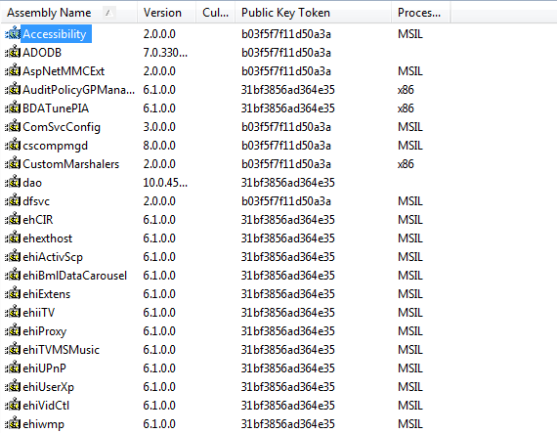
GAC-The GUI

Slide 29
Convert Private Assembly into Shared Assembly
To convert a private assembly into a shared assembly you need to follow a series of steps. They are
Convert the private assembly into a Strong-Named assembly by creating a Strong Name and signing the private assembly with that.
Convert the Strong-Named private assembly into shared assembly by registering the strong-named assembly into GAC

Slide 30
GACUTIL tool
GACUTIL Tool stands for Global Assembly Cache Utility Tool
GACUTIL tool is used to register a strongly named private assembly into GAC.
Use ‘-I’ command to install the assembly into GAC.
Additionally, you can use ‘-u’ to uninstall any shared assembly from GAC and ‘-l’ to view list of all shared assemblies installed in GAC.

Slide 31
Reference
For further details on side-by-side execution please refer this link
http://msdn.microsoft.com/en-us/library/fdhkd3a5.aspx
For further details on GAC, visit the following link
http://msdn.microsoft.com/en-us/library/yf1d93sz(v=VS.71).aspx
Notes:
Reference

